Slide 1

Advanced Programming Using Python
Anjali Kulkarni
Sept 2024

Slide 2
Day 5
Anjali Kulkarni
6 Sept 2024

Slide 3
Agenda
Revision
Functions
Exception Handling
File Handling
Quiz

Slide 4
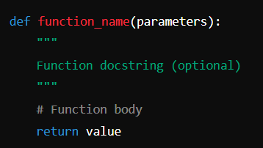
Functions
Blocks of reusable code that perform a specific task
Building blocks
Defining
Calling
Parameters
Arguments
Return values
Organize code
Make code readable
Reduce redundancy

Slide 5
Arguments (arguments.py)
Default arguments
Default arguments are specified in the function definition
Default value is used, when a value is not provided for a parameter
Default arguments must be placed after non-default arguments
Keyword Arguments / Named Arguments
Allow passing of arguments in any order by specifying the parameter names.
Keyword arguments improve code clarity.
Keyword arguments can also be used in conjunction with default arguments.

Slide 6
Special Arguments (arguments.py)
*args
Used to handle an arbitrary number of arguments
Arguments are collected into a tuple
Useful when no. of arguments is not known in advance
**kwargs
Used to handle an arbitrary number of keyword arguments
Arguments are collected into a dictionary
Useful for functions that need to handle variable no of named arguments not known in advance.

Slide 7
Return values (retValues.py)
Single Return Value
Value is returned as its type
Type is computed at runtime
Multiple return values
Return values - bundled into a tuple
How does this work?
Tuple Creation:
Python internally creates a tuple of return values
Return Value:
The tuple becomes the return value
Unpacking (Optional):
Return values can be unpacked into individual variables

Slide 8
Hands on
Assignment 1: Dynamic Sum Calculator
Objective: Write a function that takes a variable number of numerical arguments and returns their sum.
Tasks:
Implement a function ‘sum_numbers(*args)’ that calculates the sum of all arguments passed to it.
Ensure the function can handle any number of arguments.
Challenge: Modify the function to exclude negative numbers from the sum.

Slide 9
Hands on
Assignment 2: Dynamic Report Generator
Objective: Create a function that generates a report in a structured format, based on variable arguments and keyword arguments.
Tasks:
Write a function generate_report(title, *args, **kwargs)
title is the report title
*args are the report sections
**kwargs contain additional metadata like author, date, etc.
Sample Input to function generate_report :
("Monthly Sales Report", "Introduction: Overview of sales performance.", "Data Analysis: Breakdown of sales data by region.", "Market Trends: Analysis of current market trends.", author="John Doe", date=“September 2024", conclusion="Overall, sales have increased by 15% compared to the previous month.", skip_sections=[2])
Challenge: Add the ability to include optional sections or skip sections based on keyword arguments.

Slide 10
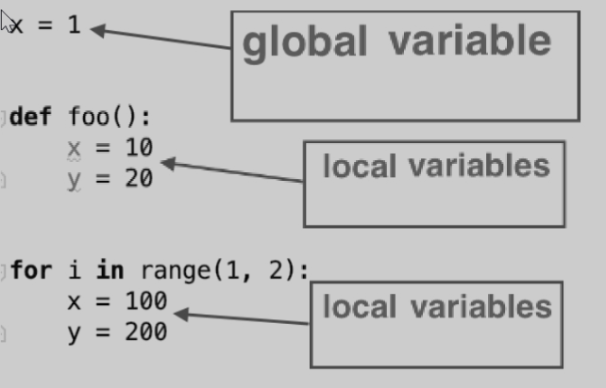
Global and local variables (variableScope.py)
Global Variables:
Defined outside of any function or block
Accessible throughout the script or module
Local Variables:
Defined within a function or block.
Accessible only within that specific function or block

Slide 11
Hands on
Assignment 3: Global and Local Summation
Objective: Create a program that calculates the sum of numbers using both global and local variables.
Tasks:
Declare a global variable to store the sum of numbers.
Write a function that accepts a list of numbers and calculates the sum using a local variable.
Update the global sum variable with the local sum calculated in the function.
Print the global sum before and after calling the function.
Challenge: Implement another function that resets the global sum to zero and compare the results.

Slide 12
Global keyword (globalKeyword.py)
Used to declare a variable as global inside a function
Allows a function to modify a global variable
Without ‘global’ keyword, a new local variable is created inside the function, leaving global variable unchanged
Use global keyword with caution - can make debugging difficult

Slide 13
Hands on
Assignment 4: Global Counter
Objective: Create a function that uses a global variable to count the number of times the function has been called.
Tasks:
Declare a global counter variable outside of the function.
Each time the function is called, increment the counter and print the current count.
Challenge: Modify the function to allow resetting the counter using an optional argument.

Slide 14
Lambda functions (lambdaFunctions.py)
A single expression that returns a value
Also called as anonymous functions
Used for
creating small, one-time and inline functions
creating higher order functions
functions like map(), filter() and reduce()
lambda arguments: expression

Slide 15
Hands On
Assignment 5: Conditional Lambda Functions
Objective: Create a program that uses a lambda function to check if a number is positive, negative, or zero.
Tasks:
Input: List of integers. E.g. numbers = [10, -5, 0, 7, -3, 4, -2]
Logic: Use the map() function with a lambda function to return "Positive", "Negative", or "Zero" based on the value of each integer.
Output: Display the resulting list of strings.
E.g. : ['Positive', 'Negative', 'Zero', 'Positive', 'Negative', 'Positive', 'Negative']

Slide 16
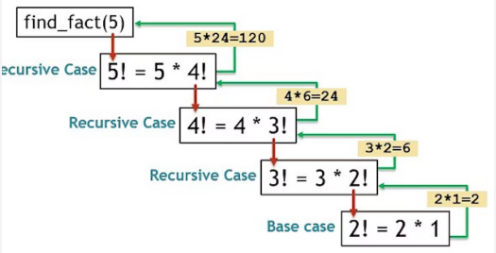
Recursions
Programming technique where a function calls itself directly or indirectly
Base Case:
The condition that stops the recursion.
Prevents the function from calling itself indefinitely.
Recursive Case:
The part of the function where the function calls itself.
Reduces the problem into smaller instances leading towards the base case.

Slide 17
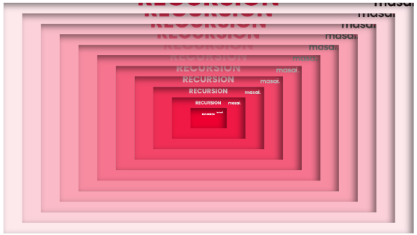
When to use recursions?
Use Recursion When:
The problem can be divided into similar sub-problems.
The problem is naturally recursive (e.g., trees, graphs).
Simplicity and clarity are more important than performance.
Avoid Recursion When:
Performance is critical and depth of recursion is large.
An iterative solution is more straightforward.

Slide 18
Hands On
Assignment 6: Convert factorial program to use recursive functions

Slide 19
Exception handling
Event that disrupts the normal flow of instructions is Exception
Exception Handling is handling errors gracefully
Why Exception handling?
To prevent the program from crashing.
To provide meaningful error messages to the user.
To handle unexpected situations gracefully.

Slide 20
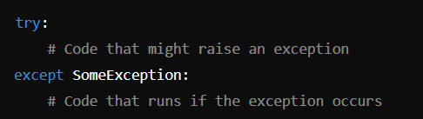
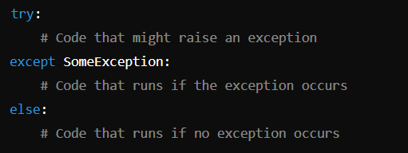
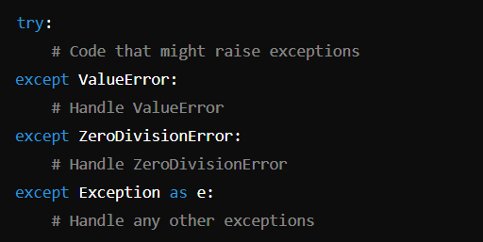
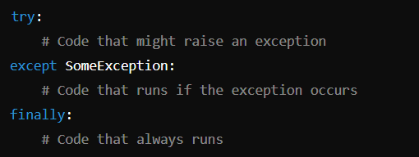

try–except block (ExceptionHandling.py)

Slide 21
Hands on
Assignment 7: Define functions which handle exceptions
Function 1: get_integer_input – Accepts an integer and prints it
Exception to handle : ValueError exceptions
Function 2: get_element_from_list - Attempts to return element at specified index from list.
Exceptions to handle :
IndexError : if the index is out of bounds
TypeError if the index is not an integer
Use else : Print the element if no exceptions occur
finally blocks : to indicate operation completion
Function3: divide_numbers(a, b) - Raises ZeroDivisionError if b is zero
Exception to handle : ZeroDivisionError - Custom message in body

Slide 22
Best practices
Avoid using a bare except clause.
Provide meaningful error messages.
Always clean up resources with finally (e.g., close files).

Slide 23
Docstrings (docStrings.py)
String literals that appear right after definition of a function and used to document the purpose of code
Accessible via __doc__ attribute or help() function
Improve code readability
Crucial for generating documentation
Can be very helpful for understanding and maintaining code over time
Syntax : " " " This is a comment for documentation purpose. " " "

Slide 24
Hands on
Assignment 8 : Add ‘docStrings’ to exception handling assignment

Slide 25
File Types and Encodings
Text Files
.txt, .csv, .log, .md
Configuration Files
.ini, .json, .yaml, .xml
Document Files
.docx, .xlsx, .pdf
Database Files
.db, .sqlite, .mdb
Encoding is method by which characters are converted into binary data
ASCII
Unicode
ISO-8859 series

Slide 26
File Handling (fileHandling.py)
Opening a File
Mode:
‘r’, ‘w’, ‘a’, ‘b’, ‘rb’, ‘wb’
Closing a File
close()
Checking if a File Exists
exists()
Writing to a File
write(string)
writelines(list_of_strings)
Reading a file
read(size)
readline()
readlines()

Slide 27
Working with csv files
csv module
Methods
csv.reader
csv.DictReader
csv.writer
csv_writer.writerows(data)
csv.DictWriter(file, fieldnames=fieldnames)
csv.DictWriter(file, fieldnames=fieldnames)
csv_writer.writerows(data)

Slide 28
Hands on
Assignment 9: Store report generated in Assignment 2 to a text file.

Slide 29
Hands on
Assignment 10: Replace a Keyword in a Text File
Search for all occurrences of keyword 'after', replace it with 'before’. Save modified content back to file.
Create functions wherever appropriate.
Handle the exception
FileNotFoundError

Slide 30
Hands on
Assignment 11: Writing Data to a CSV File
Define Data:
Create a list of dictionaries where each dictionary represents a student's record with the following fields:
ID, Name, Age, Grade
Instructions:
Use the csv module to write the list of dictionaries to a CSV file named students.csv.
The CSV file should have headers based on the dictionary keys: ID, Name, Age, and Grade.
Ensure that each record is written to a new row in the CSV file.
Function Definition:
Function 1: write_students_to_csv(filename: str, student_list: list)
Use the csv.DictWriter class to write the dictionaries to the CSV file.
Make sure to include a header row with the keys of the dictionaries.
Function 2: read_csv_and_print(filename: str)

Slide 31
Hands on
Assignment 12: Merging Files
Create a Python program that merges the contents of multiple text files into a single list, removes duplicate lines, and saves the unique lines to a new file.
Input: Two or more text files, each containing several lines of text.
Logic:
Read the content of each file into separate lists.
Merge the lists into a single list.
Convert the list to a set to remove duplicate lines.
Write unique lines to a new file named merged_unique.txt.
Output: Display the merged list and confirm that the unique lines have been saved.

Slide 32


Slide 33
Homework
Assignment 1: Temperature convertor
Input from user :
Temperature value and unit
Temperature unit to convert to
Functions :
celsius_to_fahrenheit(celsius)
fahrenheit_to_celsius(fahrenheit)
celsius_to_kelvin(celsius)
Employ exception handling for checking numeric values.
Finally and else block

Slide 34
Thank You !!

